Slide 1
CROWD DETECTION AND TRACKING FROM MULTI-CAMERA SURVEILLANCE VIDEOS
By: Sarika Sasi A

Slide 2
PROBLEM STATEMENT
To design a model for crowd detection and tracking along with the behavior of the crowd from multi-camera surveillance visuals.

Slide 3
EXISTING METHODS
Detection: YOLOv3, YOLOv4
Tracking: Kalman Filter, Deep SORT
Matching: Histogram, SSIM

Slide 4
PROPOSED SOLUTION
For detection of pedestrians from the video YOLOv4 algorithm is used.
Track person using Deep-SORT algorithm, a unique ID for each person present in the frame.
Two cameras, primary camera, and secondary camera.
Primary camera do initial processing, Deep SORT is applied.
Matching people using Histogram
Detect people in other cameras and count the number of people.

Slide 5
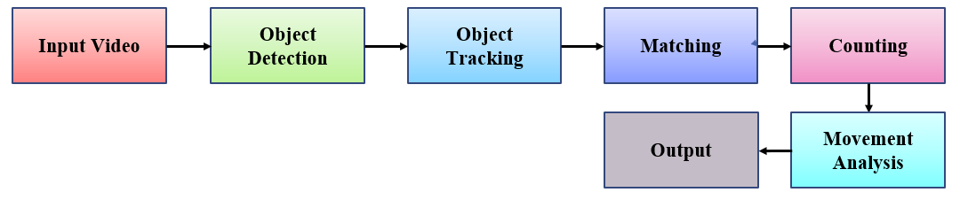
ARCHITECTURE AND SYSTEM DESIGN
Dataset: CAVIAR Test case scenarios, EPFL videos
Input: Video sequence from multiple cameras.
Object Detection: Detection of pedestrians from the video using YOLOV4 algorithm.
Object Tracking: Tracks the pedestrians by giving unique ID.
Counting: Zonal counting to count the number of people.
Movement analysis: Movement trajectory is obtained

Slide 6
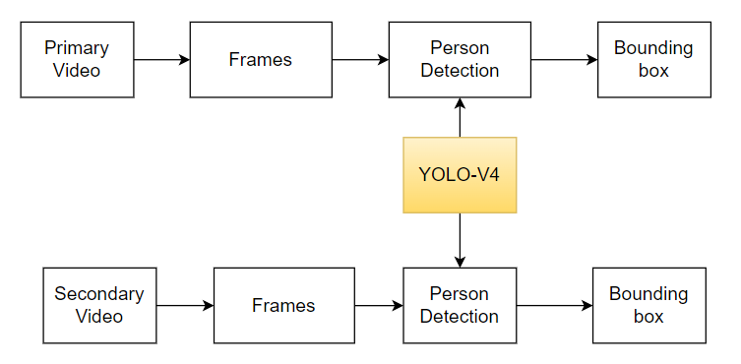
DESIGN DIAGRAMS
Person Detection
Input: Multi-camera video of same location.
Person detection: YOLOV4 pre-trained on COCO dataset.

Slide 7
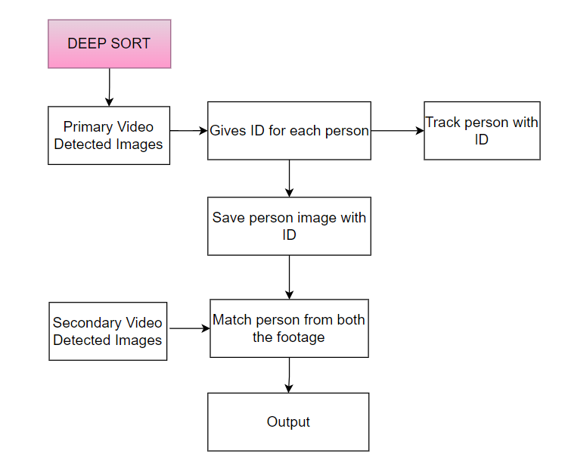
People Tracking
Input: YOLOV4 detected images.

Slide 8
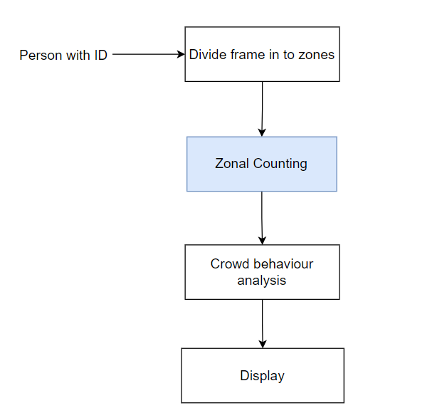
People Counting
Divide frame in to four zones.

Slide 9
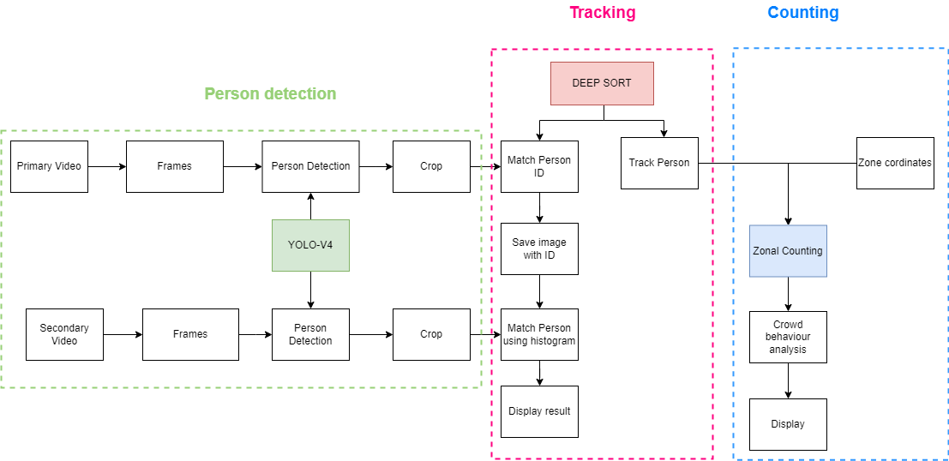
PROJECT ARCHITECTURE

Slide 10
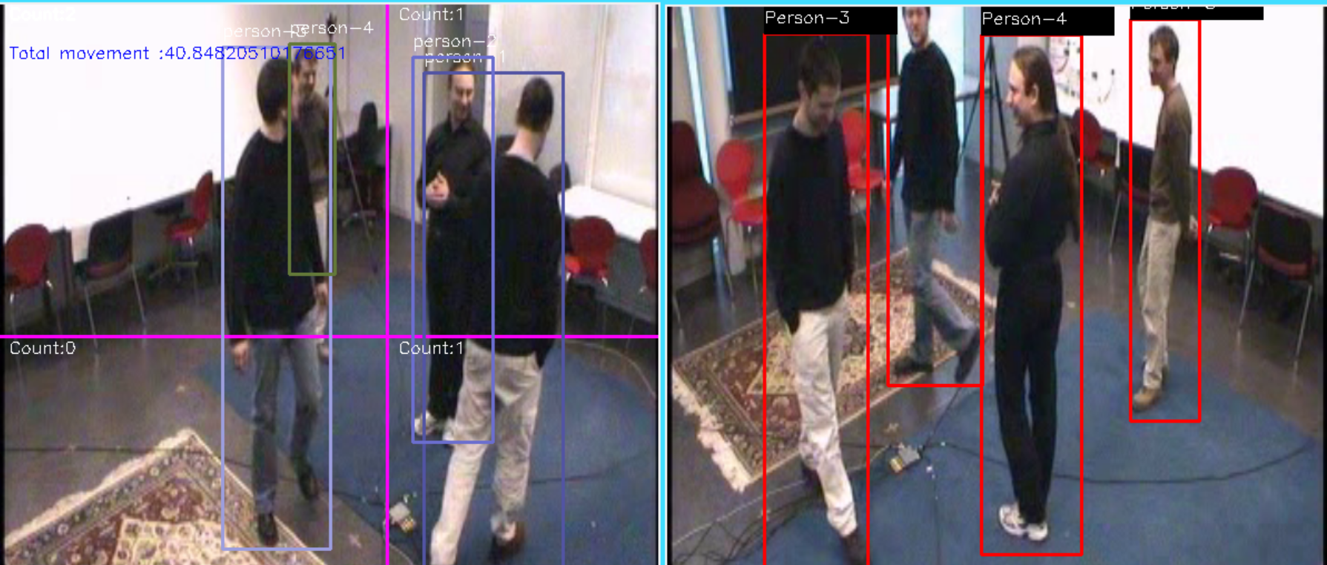
RESULT

Slide 11
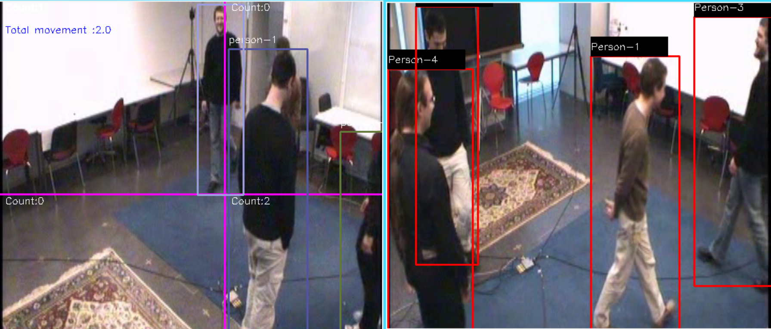

Slide 12
CONCLUSION
In the surveillance world, counting people and detecting their numbers are essential.
YOLOv4 and Deep SORT are used for detection and tracking.
Low accuracy because of occlusion.
People with same features leads to mismatching.
In the future matching can be improved and this project can be used as a reference for future works.

Slide 13
REFERENCES
[1] Xie, Shaoci, Xiaohong Zhang, and Jing Cai. "Video crowd detection and abnormal behavior model detection based on machine learning method." Neural Computing and Applications 31.1 (2019): 175-184.
[2] Ullah, Habib, et al. "Multi-feature-based crowd video modeling for visual event detection." Multimedia Systems 27.4 (2021): 589-597.
[3] Xu, Jian, Chunjuan Bo, and Dong Wang. "A novel multi-target multi-camera tracking approach based on feature grouping." Computers & Electrical Engineering 92 (2021): 107153.
[4]Shorfuzzaman, Mohammad, M. Shamim Hossain, and Mohammed F. Alhamid. "Towards the sustainable development of smart cities through mass video surveillance: A response to the COVID-19 pandemic." Sustainable cities and society 64 (2021): 102582.

Slide 14
[5] Shareef, Ahmed Abdullah A., et al. "YOLOv4-Based Monitoring Model for COVID-19 Social Distancing Control." Smart Systems: Innovations in Computing. Springer, Singapore, 2022. 333-346.
[6] Feng, Fujian, et al. "Abnormal Crowd Behavior Detection Based on Movement Trajectory." Chinese Conference on Image and Graphics Technologies. Springer, Singapore, 2020.
[7] Ciaparrone, Gioele, et al. "Deep learning in video multi-object tracking: A survey." Neurocomputing 381 (2021): 61-88.
[8] Amir Sjarif, Nilam Nur, et al. "Crowd analysis and its applications." International Conference on Software Engineering and Computer Systems. Springer, Berlin, Heidelberg, 2011.
[9] Zaidi, Syed Sahil Abbas, et al. "A survey of modern deep learning based object detection models." arXiv preprint arXiv:2104.11892 (2021).

Slide 15
THANK YOU

